Slide 1

Utah Housing Strategic Plan

Slide 2

Utah Housing Strategic Plan
This plan is intended to:
Outline a collaborative and strategic approach to addressing the state’s housing needs.
Map out an action plan for housing stakeholders.
Serve as a foundation to guide all future housing policy discussions.
Update the existing state Moderate Income Housing Plan and reporting requirements.
Notes:
Steve

Slide 3
Participating Stakeholders
Over 100 individuals engaged including people representing:
American Planning Association
Clyde Companies
Community Reinvestment Agency
Division of Housing & Community Development
Envision Utah
Fieldstone Homes
Gateway & Natural Amenity Region (GNAR)
Giv Group
Governor's Office of Planning and Budget
Habitat for Humanity
Home Builders Association
Ivory Homes
KKOS Law Firm Salt Lake City
Kem C. Gardner Policy Institute
Millcreek City
Moab Community Land Trust
Mountainland Association of Governments
Nilson Homes
R6 Regional Council
Rio Tinto
Rocky Mountain Community Reinvestment Corporation
Salt Lake County
School and Institutional Trust Lands Administration
South Eastern Regional Development Agency
The Richman Group Affordable Housing Corporation
Tooele Housing Authority
USDA Rural Development
Utah Association of Counties
Utah Association of Mortgage Professionals
Utah Clean Energy
Utah Home Builders Association
Utah Housing Coalition
Utah Housing Corporation
Utah League of Cities and Towns
Utah Legislature
Utah Office of Homeless Services
Utah Realtors Association
Utah Transit Authority
Wasatch Front Regional Council
Weber County
Notes:
Steve

Slide 4
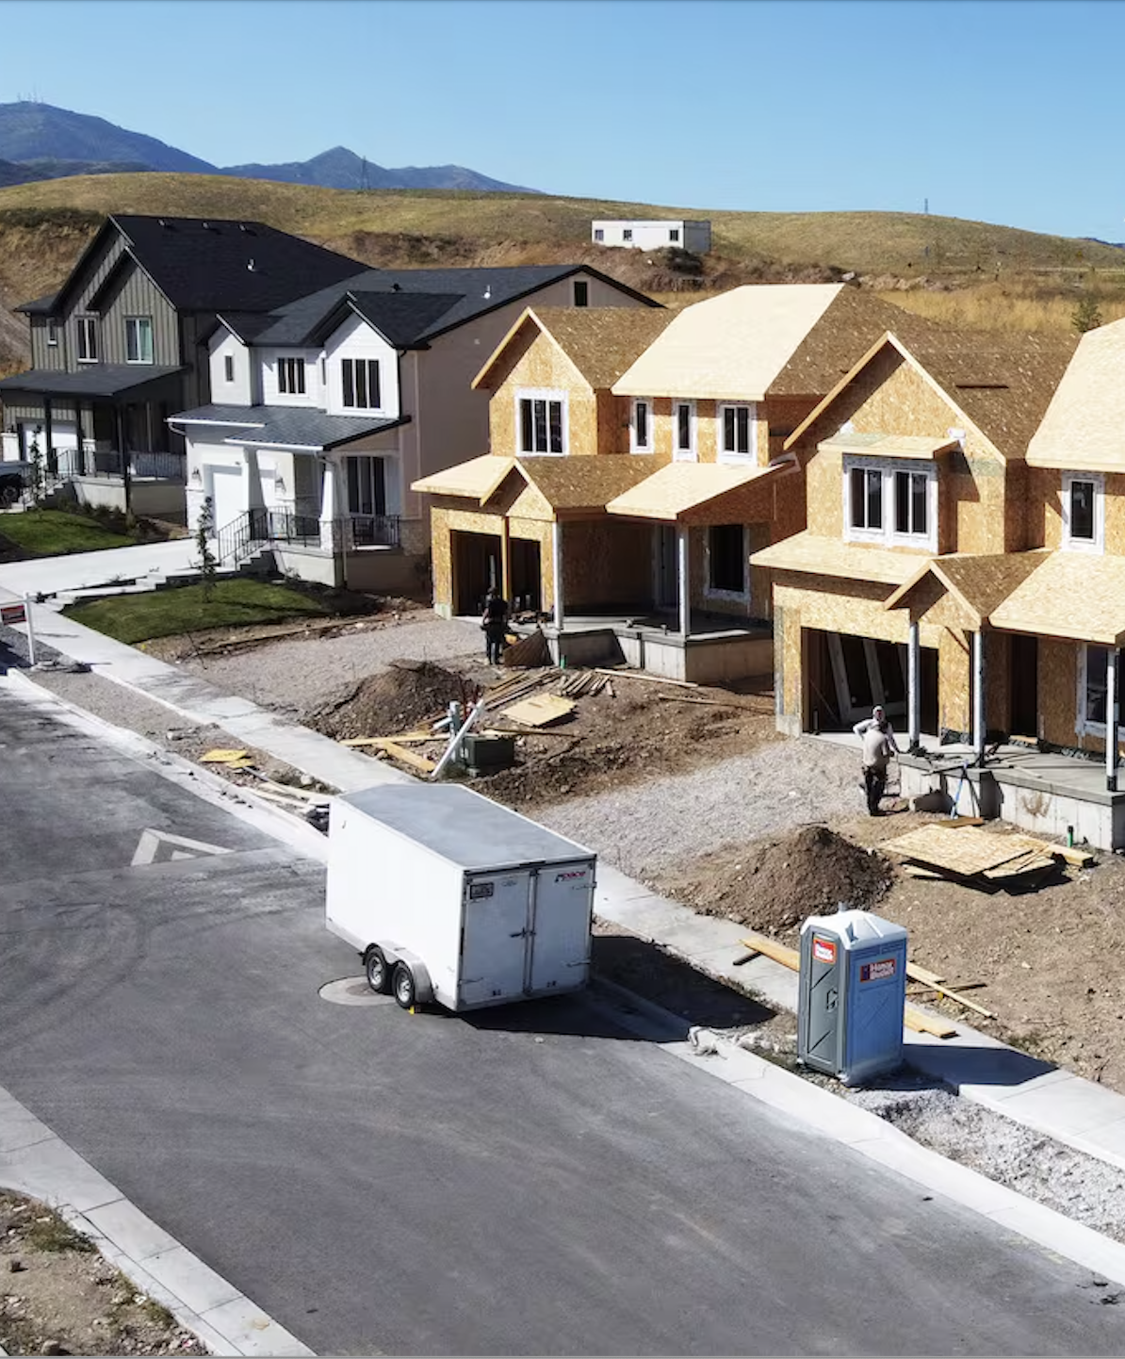
Timeline
Phase I
Kickoff September 2024
Draft Plan Due January 2025
Legislator Outreach January 2025
Public Comment Jan- Mar 2025
Phase II
Kickoff April 2025
Legislator Outreach May 2025
Draft Plan Due September 2025
Legislator Outreach September 2025
Public Comment Oct-Nov 2025
Final Plan Due December 2025
Notes:
Laura

Slide 5
The Process
PHASE I - What can we all agree upon?
Established shared Goals & Guiding Principles.
Inventoried available data and housing support structure information.
Collected a wide range of suggested tactics.
PHASE II - How can we build upon and advance this agreement?
Complete: Metric data collection, analysis, and reporting
Complete: Prioritized list of tactic recommendations
In Progress: Implementation plan
In Progress: Housing support structures alignment
Notes:
Laura

Slide 6






Administration Priorities
Deliver to market at least 150,000 new housing units
by the end of the second term including:
35,000 new starter homes &
40,000 new homes in identified regional centers.
Small Town
Center
Neighborhood
Center
Mixed-Use
Corridor
City
Center
Urban
Center
Metro
Center

Slide 7
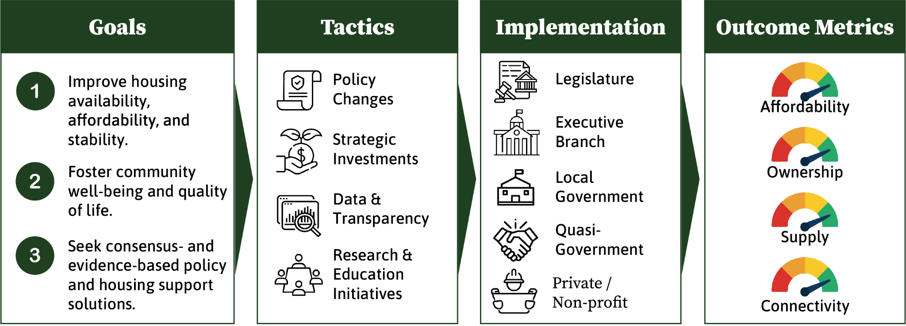
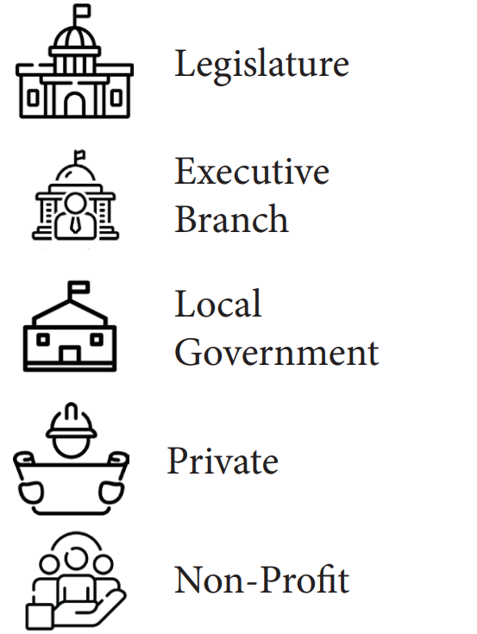
Strategic Plan Approach
Notes:
Laura

Slide 8

Goals
1.
Improve housing availability, affordability, and stability.
2.
Foster community well-being and quality of life.
3.
Seek consensus- and evidence-based policy and housing support solutions.
Notes:
Laura

Slide 9
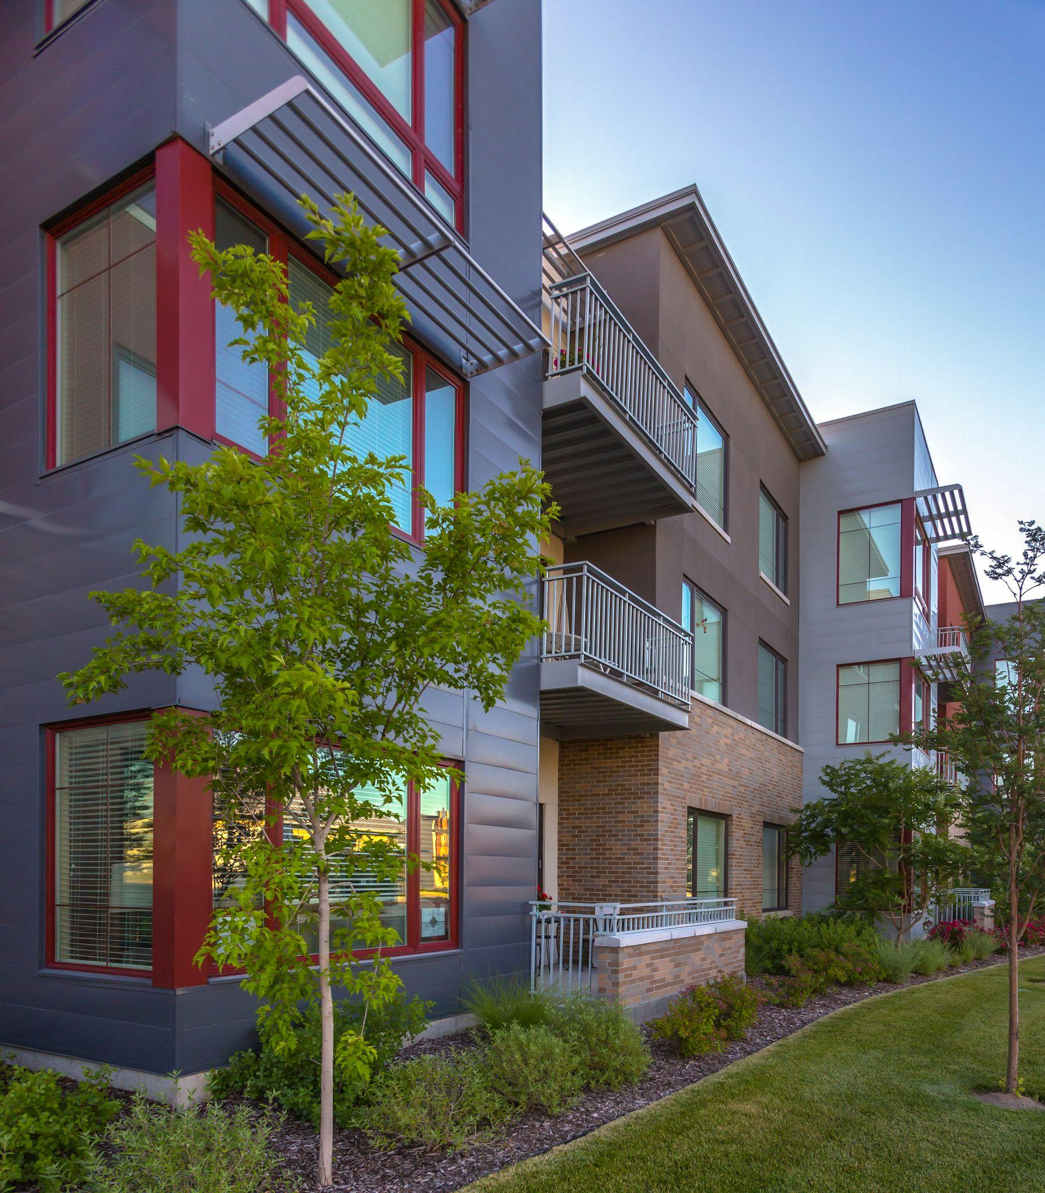
Guiding Principles
Prioritize collaboration over preemption
Promote a holistic and regional approach
Collaborate across sectors
Enable connected communities and center-based development
Acknowledge cross-Issue Policy alignment
Maintain a long-range vision
Promote opportunity and inclusivity
Recognize complex market forces
Consider rural context
Notes:
Laura

Slide 10




Tactics
From 300+ to 46
Policy Changes
Education Initiatives
Strategic
Investments
Data & Transparency
Notes:
Laura

Slide 11
Top Priority Tactics - DRAFT
Inventory, analyze, and develop a plan for publicly-owned land that may be suitable for future housing.
Expand funding, including leveraging federal grants, for an infrastructure revolving loan fund to support implementation of station area plans and new master planned developments which may be repaid by development.
Secure ongoing funding for a revolving loan fund to provide low- or zero-interest loans for the acquisition and development of affordable housing projects; may be repaid by development.
Per HCR14 (2025) streamline Utah's executive branch and independent entity housing program administration and funding.
Provide training and technical assistance to resource-constrained local governments and growing communities to help them streamline housing development processes.
Notes:
Laura

Slide 12
Other Priority Tactics - DRAFT
Incentivize local governments to implement zoning reforms by leveraging existing state funding programs to offer priority to cities that are implementing the state's housing priorities of starter homes, station area plans, missing middle housing, and condominiums.
Conduct an analysis of the potential benefits and structural requirements of other shared equity models, such as Community Land Trusts or Limited Equity Cooperatives, and disseminate findings.
Review and revise state statute to require cities and towns to allow detached ADUs (DADUs), with reasonable considerations for infrastructure capacity, parking, public safety and health, etc.
Reauthorize existing state tax credits by removing the sunset date from state code sections 59-7-607 and 59-10-1010.
As part of streamlining Utah housing policies per HCR14 (2025), assign the new housing division the responsibility to coordinate the use of federal, state, and other funds to implement regional housing projects and solutions.
Notes:
Laura

Slide 13
Other Priority Tactics - DRAFT
Incentivize local governments to implement zoning reforms by leveraging existing state funding programs to offer priority to cities that are meeting housing goals.
Per HCR14 (2025) streamline Utah's executive branch and independent entity housing program administration and funding.
Review and revise state statute to require cities and towns to allow detached ADUs (DADUs), with reasonable considerations for infrastructure capacity, parking, public safety and health, etc.
Reauthorize existing state tax credits by removing the sunset date from state code sections 59-7-607 and 59-10-1010.
Convene a working group to explore ways to better utilize the state's Medicaid funding to provide wraparound supports to accompany deeply affordable housing initiatives.
Conduct a comprehensive study to estimate realistic limits to growth and additional housing from water supply constraints.
Implement reasonable, minimum regulations for short-term rentals such as requiring a local management contact, maximum occupancy limits, basic fire and safety measures, homeowner-held licenses or permits, and payment of Transient Room Tax.
Fund and host efforts to plan for growth at the state, regional, and local level by engaging the public in conversations (community forums, workshops, surveys, etc.), including the benefits of center-based development patterns.
Require all publicly funded housing to maintain affordability through long term deed restrictions.
Notes:
Laura

Slide 14
Plan Implementation
The plan is an actionable work plan for policy makers across the state toward achieving our collective housing vision.
State legislation & appropriations
Reorganization of state agency responsibilities
New state initiatives and projects
Local government planning and ordinance updates
Project-level application of principles
Data development, tracking and analysis
Notes:
Steve

Slide 15
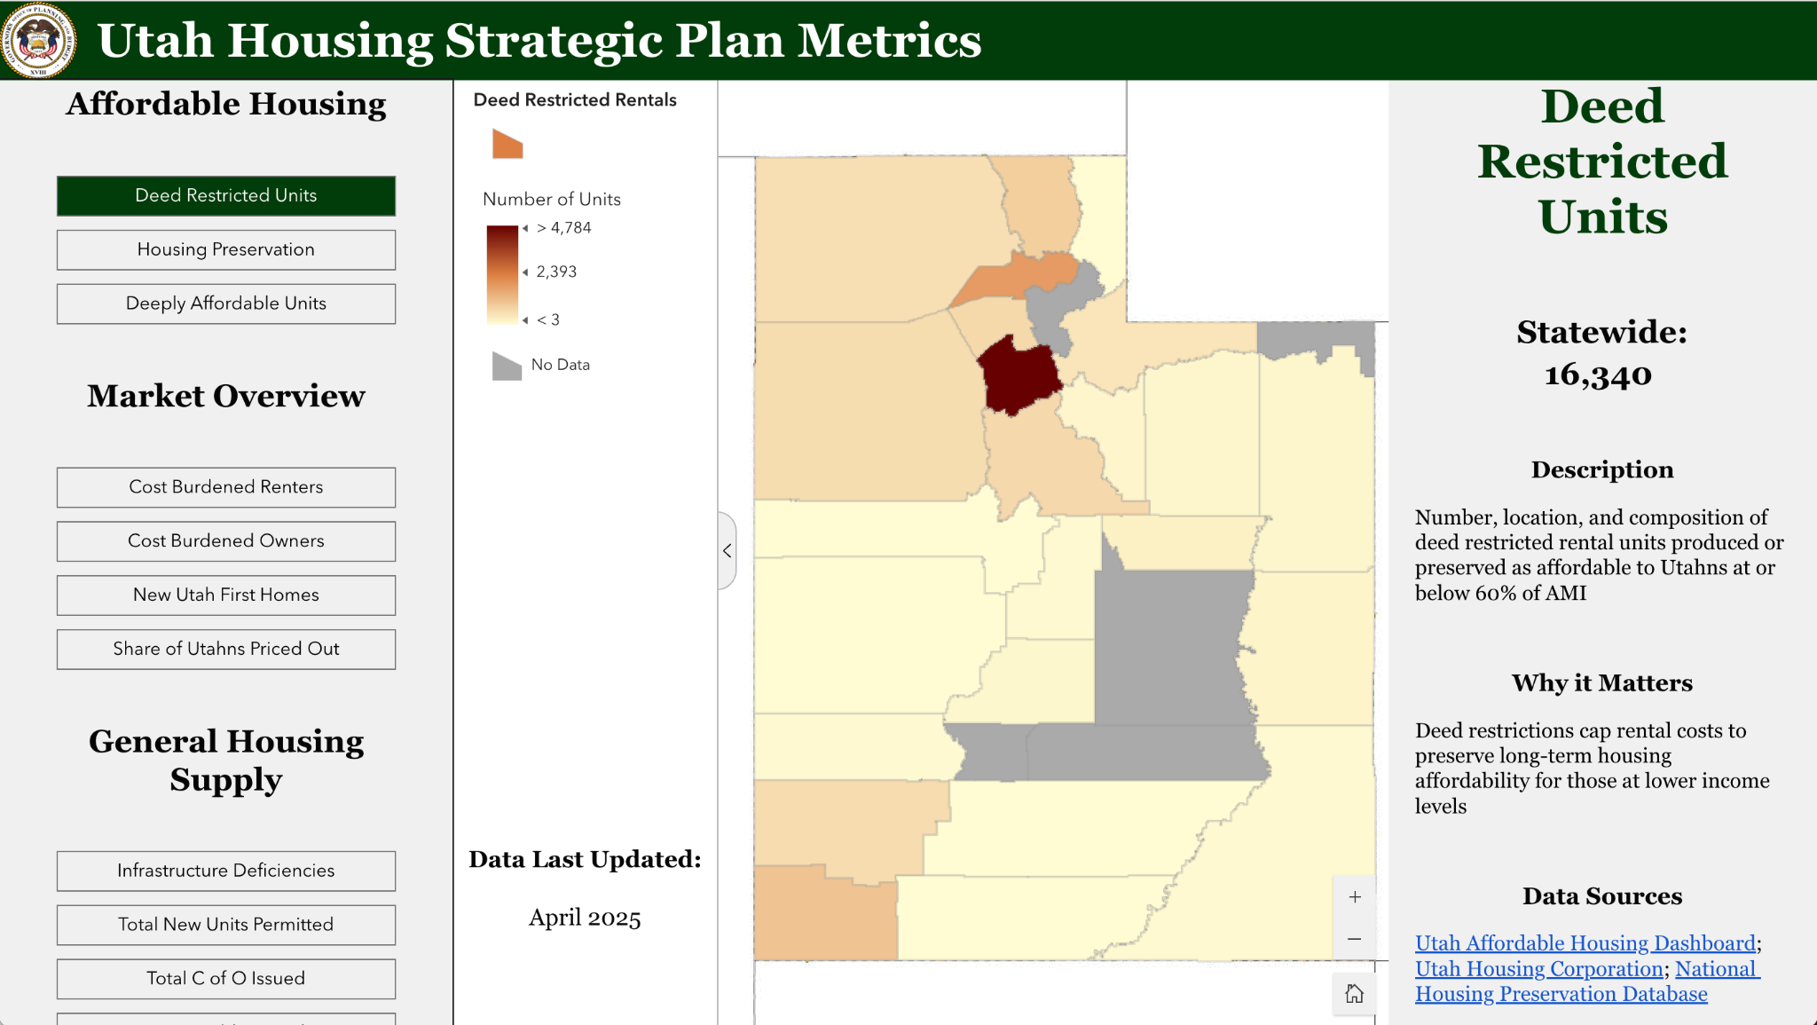
Notes:
Laura

Slide 16

The Utah Way
Increased Commitment and Buy-In
Durable and Challenge-Resistant Outcomes
Higher Quality and Creative Solutions
Increased Trust and Stronger Relationships
Empowered Stakeholders
Shared Learning and Understanding
Notes:
Laura

Slide 17
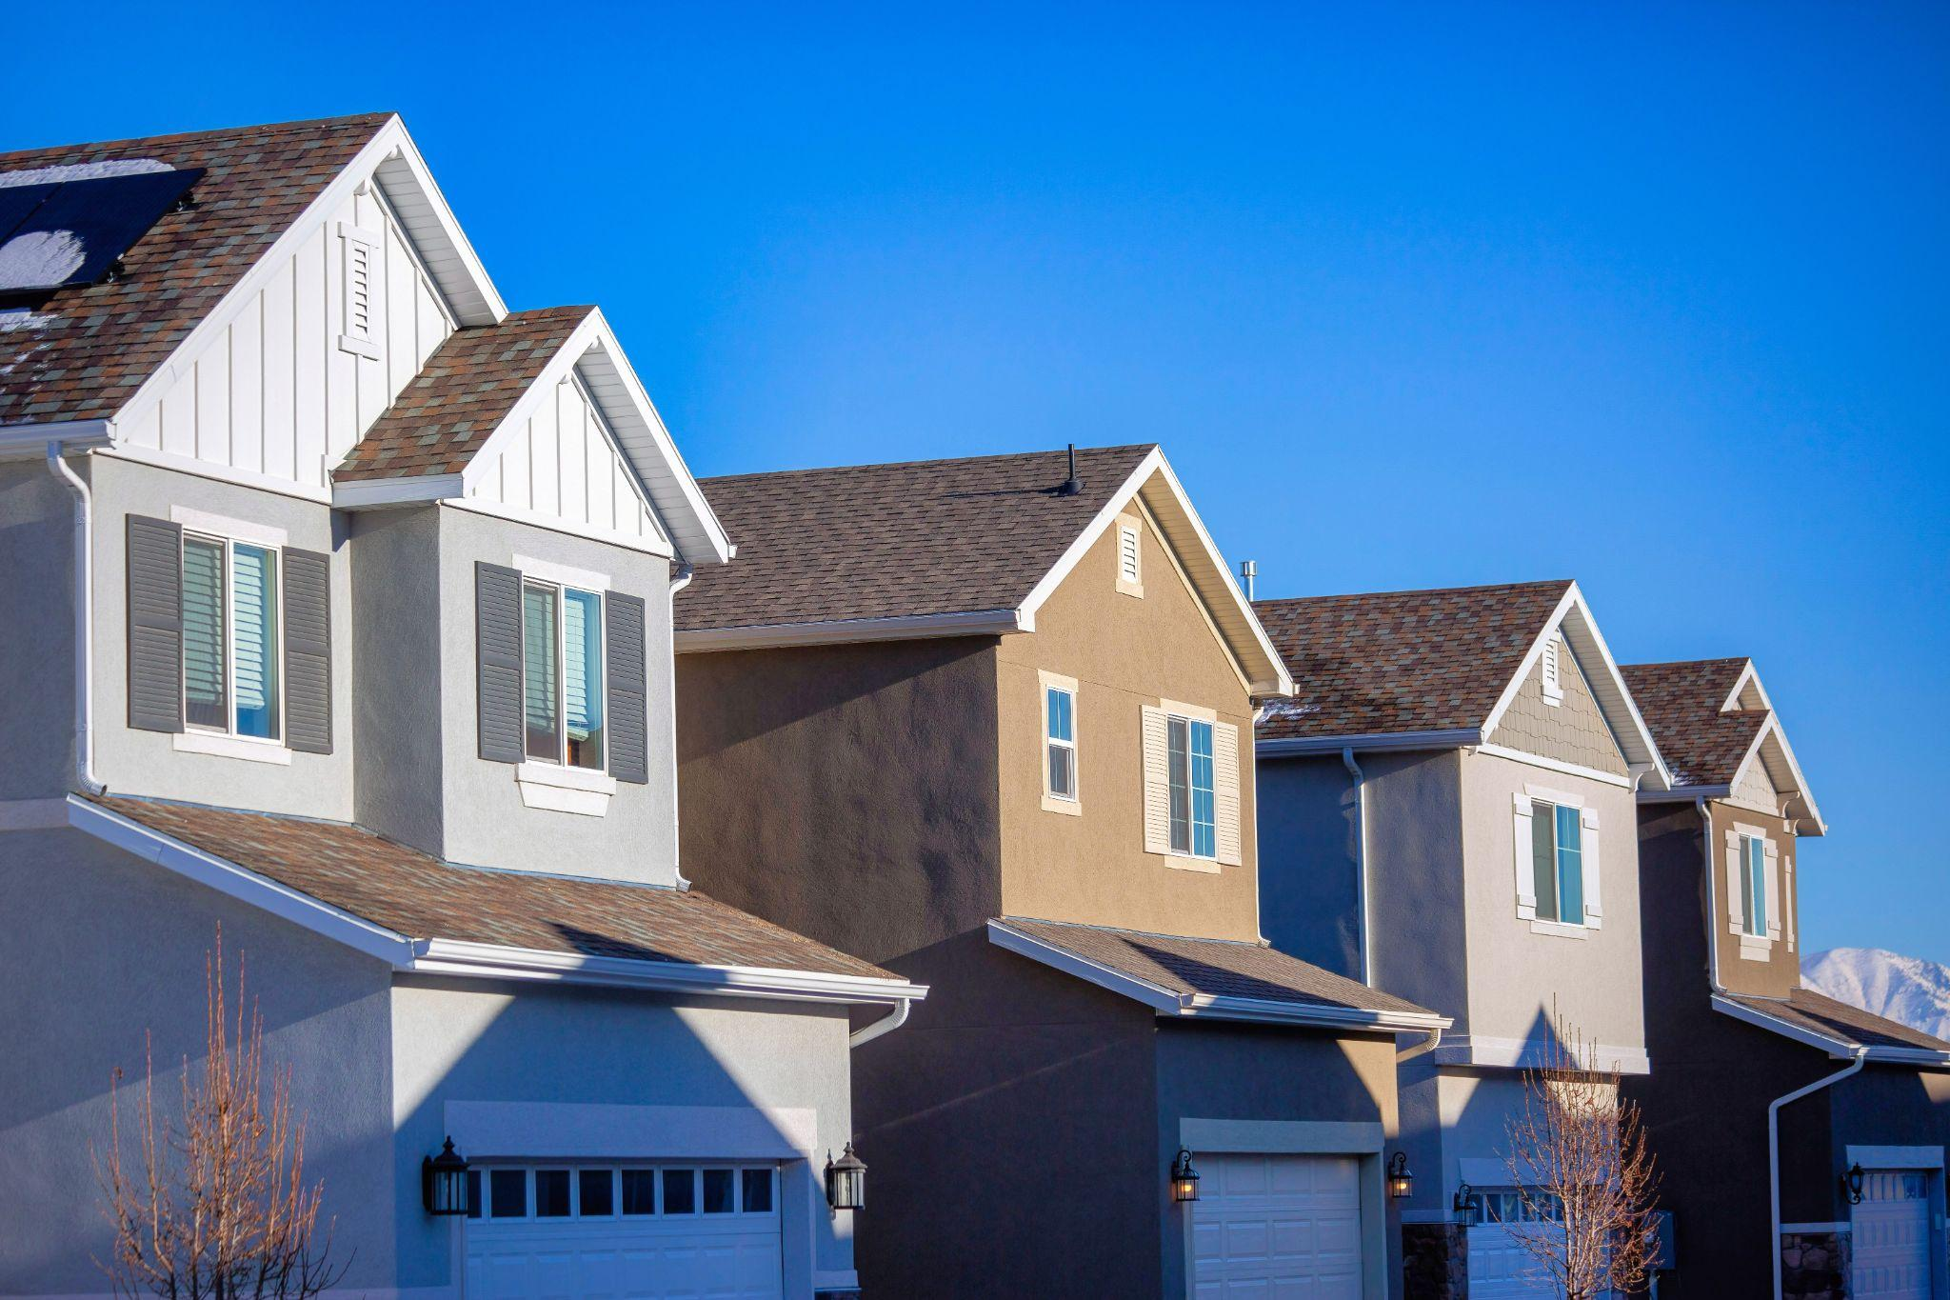

Utah Housing Strategic Plan
governor.utah.gov/housing
Steve Waldrip
Senior Advisor for Housing Strategy & Innovation
801-389-9329
swaldrip@utah.gov
Laura Hanson
Senior Advisor for Long-Range Planning 801-589-8479
laurahanson@utah.gov

