Slide 1
Part I, the Need for Speed
Considerations from the development/property owner perspective
Chris Gamvroulas, Ivory Development

Slide 2
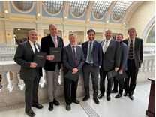
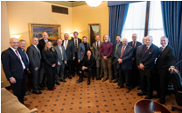
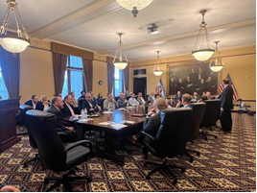
Recent efforts to expedite development
Insert Presentation Title Here

Slide 3
Recent efforts to speed development
Plat process improvements
Identical plans
Fixed time periods
Review cycles
Tighter exaction standards
Water
Road widths
Bonding (sidewalks/landscaping)

Slide 4
What’s Next
Work with League of Cities and Towns and other stakeholders
Identify items to implement best practices
Work collaboratively to further knowledge about existing laws
Emphasize that the current tools are sufficient for most circumstances

Slide 5
Part II, the Need for Speed
Additional Perspectives

Slide 6
Phase II Presenters
Representative Ray Ward
Francis Lily, Millcreek City
Jim Kaiserman, Wasatch/Rich Surveyor (retired)

Slide 7
Part II Presentation
Policies Advanced Through Speedier Processes
Provide predictability
Reduce financing, legal, opportunity and other costs
Promote affordability without subsidy
Incentivize infill and smaller scale projects.

Slide 8
Part II Presentation
City Initiatives
Clarify ordinances
Checklists, user guides
Effective use of DRCs
Streamlining subdivisions
Address internal timelines within the city departments

Slide 9
Practice Pointer
Utilize Shot Clocks if a project is delayed:
Utah Code 10-20-905(1)(c), seek confirmation of a complete application within 30 days of submission.
Utah Code 10-20-905 (2)(c), obtain final action within 45 days, either zoning petition or land use decision

Slide 10
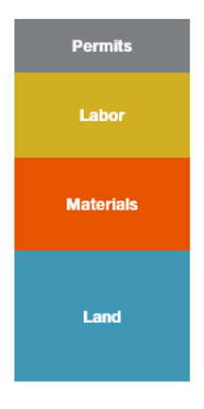
Cost Components of Real Estate Development
Fixed Development Costs
Developers have little to no control over the cost of land, materials, labor, and permits

